Slide 1
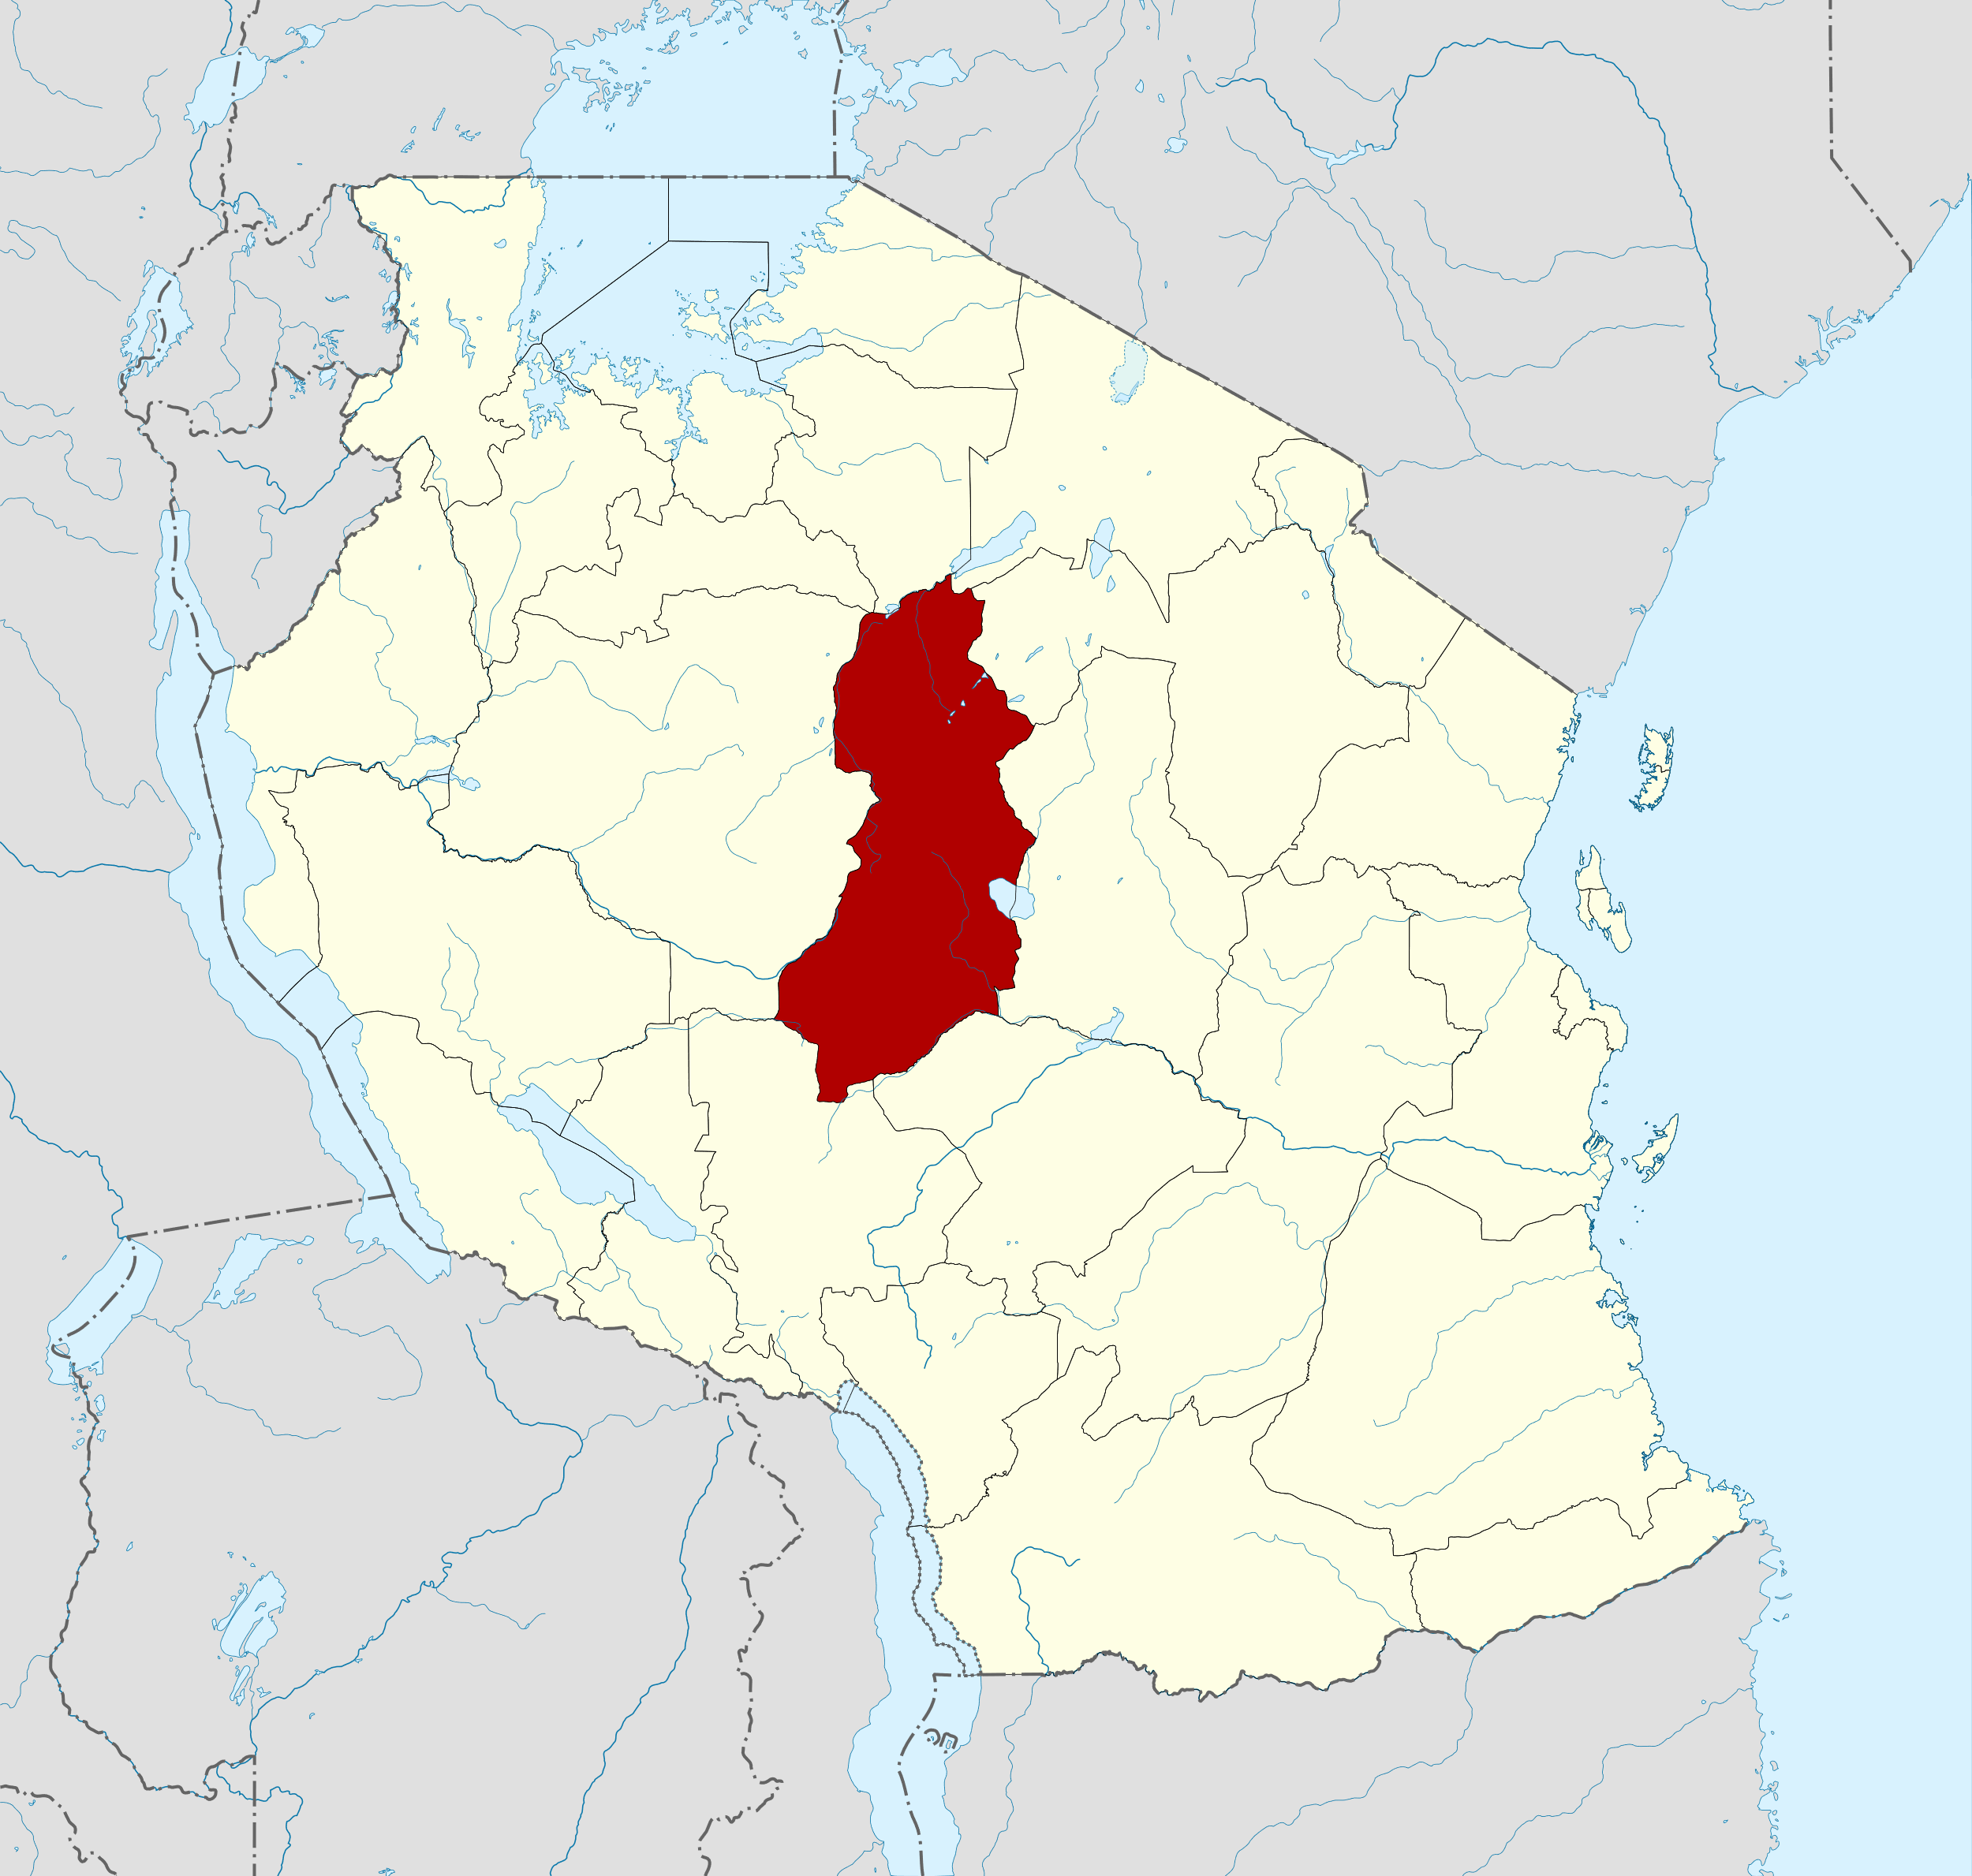


1
Overview
Region:
Singida, Tanzania
Main Problem:
serious post-harvest losses
Low added value
Solution:
Storage facilities
Sorghum processing
Map from: https://en.wikipedia.org/wiki/Singida_Region

Slide 2
2
Problem Statement
Storage facilities
Serious post-harvest losses
Household level storage
Community warehousing
Storage pests
15%-20%
lost caused by storage facilities
16%
famers think pest is the main factor
Low added value
80% smallholders
Smallholder is the mainstay
Sorghum is widely grown
Extensive business model
Low grade processing

Slide 3
3
Solution
Storage facilities
Establishing granaries
Low added value
Sorghum processing plants

Slide 4
Reference
Foreign Economic Cooperation Center of the Ministry of Agriculture of China 2018, Conditions and Characteristics of Tanzania's Agricultural Development, viewed 20 October 2021, http://www.agri.cn/V20/ZX/sjny/201811/t20181113_6283410.htm
Taruvinga, C 2018, Tanzania Cereal Storage Scoping Mission, viewed 20 October 2021, https://www.canr.msu.edu/fsp/news/Paper_2.1._FAO_Cephas_Taruvinga.pdf
Abass, AB, Ndunguru, G, Mamiro, P, Alenkhe, B, Mlingi, N & Bekunda, M, 2014, Post-harvest food losses in amaize-based farming system of semi-arid savannah area of Tanzania, Journal of Stored Products Research, Vol. 57, pp. 49-57, viewed 20 October 2021, https://core.ac.uk/download/pdf/82311085.pdf

